Slide 1
Country Name Year
Local Governance Institutions Comparative Assessment LoGICA Intergovernmental Profile
LOCAL PUBLIC SECTOR
ALLIANCE

Slide 2
How empowered are subnational officials…
6.
Devolved subnational government with extensive autonomy and authority
5.
Devolved subnational government with limited autonomy and authority
General amount of power, authority and resources provided to subnational governance institutions
4.
Hybrid subnational governance institutions
1 / 2 / 3.
Non-devolved subnational governance institutions
Subnational governance institutions
Notes:
The LoGICA framework provides a typology that allows subnational (regional or local) governance institutions to be classified into six different categories, ranging from subnational governments with authoritative decision-making power over a wide range of functions (extensive devolution) to subnational governance institutions that are not legal, administrative or fiscal entities in their own right and/or that lack political, administrative and/or fiscal powers.

Slide 3
Hex code color scheme to indicate different subnational governance institutions:
6 – Extensive Devolution
#A72525 – Devolved subnat. governments with extensive powers and functions
5 Limited Devolution
#FDA751 – Devolved subnat. governments with limited powers or functions
4 – Hybrid institution
#E2D05D – Hybrid subnational governance institutions
1/2/3 –
Non-devolved
#2E5496 – Non-devolved subnational governance institutions

Slide 4
Sample diagrams of territorial-administrative structures

Slide 5
Central level
Central government
Local level
Municipalities (n)

Slide 6
Central level
Central government
Regional level
Regional administrations (n)
Local level
Local government authorities (o)

Slide 7
National level
National government
Regional level
Provinces (9)
Autonom. Region
Local level
District (o)
Urban authorities (p)
Lower-local level
Village governments (q)

Slide 8
Central level
Central government
Regional level
Regional governments
Regional administration
Local level
Local governments
Local administration

Slide 9
National level
Central government
Primary
subdivision
Regional administration
Metropolitan corporations
Second-level
subdivision
Rural district administration
Municipal
govern.

Slide 10
Federal level
Federal government (1)
State level
State governments plus D.C. (50+1)
Territories
(5)
Local level
County governments (3,031)
Tribal gov. (573)
School district governments (12,754)
Municipal & township governments (35,748)

Slide 11
Federal level
Federal government
State level
Federal States (Area States)
City States
Local level
Government Districts
(Rural) Districts
Urban Districts / Independent Cities
Collective municipalities
Municipalities
Local municipalities

Slide 12
Sample illustrations of the LoGICA subnational institutional typology

Slide 13
Subnational governance institutions

Slide 14
Subnational governance institutions

Slide 15
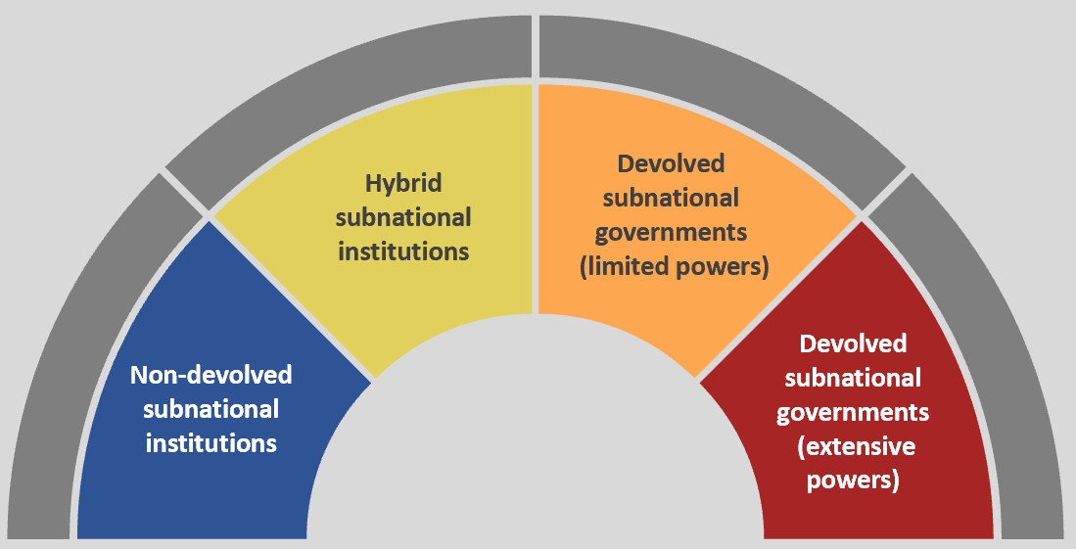
Subnational governance institutions
Regional administration
Local
governments
LOCAL PUBLIC SECTOR
ALLIANCE

Slide 16
Subnational governance institutions
State
governments
County governments
Sub-county governments
School district governments
LOCAL PUBLIC SECTOR
ALLIANCE

Slide 17
YES
6 – Extensive Devolution
3. Extensive powers and functions ?
2. Autonomy and authoritative decision-making ?
YES
NO
5 - Limited Devolution
NO
YES
4 – Hybrid institution
1. Preconditions
of subnational government met?
Non-devolved
(1 / 2 / 3)
NO

Slide 18
G5. Nature of subnational governance institutions | G4. Nature of subnational governance institutions
0 - Geographic jurisdictions | 1 - Other subnational institutions | 2 -Vertically (sectorally) or other deconcentrated institutions | 3 - Horizontally (territorially) deconcentrated institutions | 4 - Hybrid subnational governance institutions | 5 - Devolved subnational government (limited powers) | 6 - Devolved subnational government (extensive powers)
Subnational subdivisions lack formal institutional structure | Subnational subdivisions have other institutional structure | Subnational unit is administratively and budgetarily a hierarchical part of a higher-level government |  | Institution combines elements of devolution and non-devolved inst. | Institution is corporate body Own (elected) political leadership Control over officers and staff Own budget and accounts
Subnational subdivisions that lack (any / clear / formal) institutional structure | Subnational subdivisions with other institutional structure (e.g., coordinating authority) | Subnational units are part of their respective central line ministry budgets Subnational institutions / units lacks consolidated administrative structure | Subnational subdivisions are included in central budget territorially and are administered as consolidated or integrated territorial-administrative units | Pro forma subnational governments that lack de facto authoritative decision-making power Subnational entities with formal dual subordination | General-purpose governments that are limited in one or more aspects of local governance Special-purpose government (i.e., limited in functional responsibilities) | General-purpose governments with elected leadership that fully adhere to IMF definition of subnational governments, and have extensive functional responsibilities

Slide 19
How empowered are subnational officials…
6.
Devolved subnational government with extensive autonomy and authority
5.
Devolved subnational government with limited autonomy and authority
4.
Hybrid subnational governance institutions
General amount of power, authority and resources provided to subnational governance institutions
3.
Horizontal deconcentr. (territorially-empowered field administration)
2. Vertical/other deconcentr. (sectorally-empowered field administration)
1. Other subnational governance institution
Subnational governance institutions

Slide 20
Hex code color scheme to indicate different subnational governance institutions:
6 – Extensive Devolution
#A72525 – Devolved local governments with extensive powers and functions
5 Limited Devolution
#FDA751 – Devolved local governments with limited powers or functions
4 – Hybrid institution
#E2D05D – Hybrid local governance institutions
3 – Horizontal deconcentration
#89A6DB – Horizontally deconcentrated subnational institutions
2 –Vertical / other deconcentration
#2E5496 – Vertically (or other) deconcentrated subnational institutions
1 - Other institution
#1C3561 – Oher subnational institutions

Slide 21
YES
6 – Extensive Devolution
3. Extensive powers and functions ?
2. Autonomy and authoritative decision-making ?
YES
NO
5 - Limited Devolution
NO
YES
4 – Hybrid institution
1. Preconditions
of subnational government met?
3 – Horizontal deconcentration
YES
5. Horizontal deconcentration criteria met?
NO
YES
2 –Vertical/other deconcentration
NO
4. Deconcentrated budget entity?
NO
1 - Other institution

Slide 22
Subnational governance institutions
Territorially
deconcentrated institutions
Hybrid
subnational institutions
Devolved
subnational governments
(limited powers)
Sectorally
deconcentrated institutions
Devolved
subnational governments (extensive powers)
Other
institutions
LOCAL PUBLIC SECTOR
ALLIANCE

Slide 23
Subnational governance institutions
Territorially
deconcentrated institutions
Hybrid
subnational institutions
Devolved
subnational governments
(limited powers)
Sectorally
deconcentrated institutions
Devolved
subnational governments (extensive powers)
Other
institutions

Slide 24
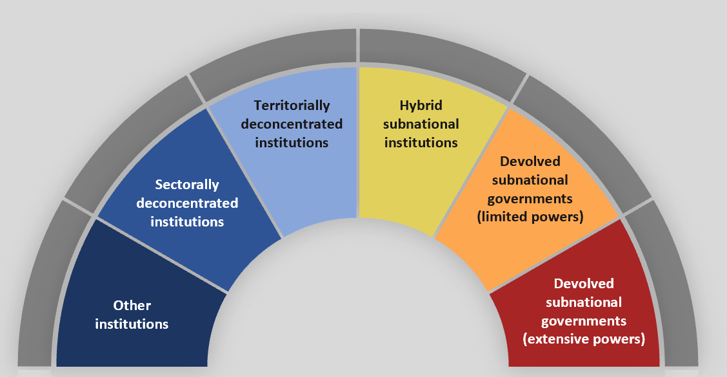
Subnational governance institutions
Regional administration
Local
governments
LOCAL PUBLIC SECTOR
ALLIANCE

Slide 25
Subnational governance institutions
State
governments
County governments
Sub-county governments
School district governments
LOCAL PUBLIC SECTOR
ALLIANCE

